Slide 1
What is the ADP NER?
ADP, a payroll service provider, produces an estimate of total employment in the US each month through its National Employment Report (NER).
The NER is closely watched by journalists and financial markets as it provides an indicator of the health of the economy and comes out a few days ahead of the official government employment report.
These data are displayed in a static format on the report’s website.
Our aim is to explore new and interactive ways for users to engage with the data and easily consume the economic insights that emerge from them.

Slide 2
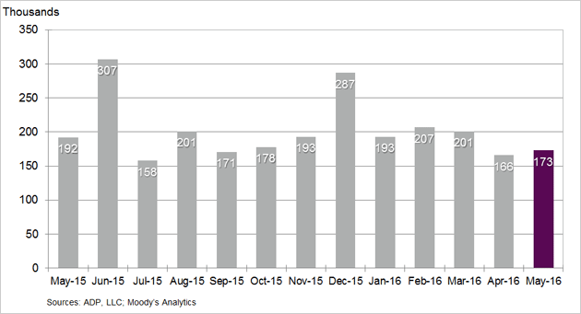
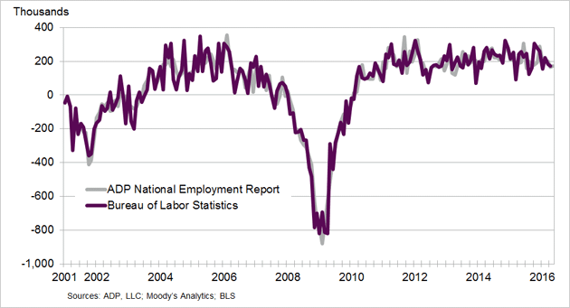
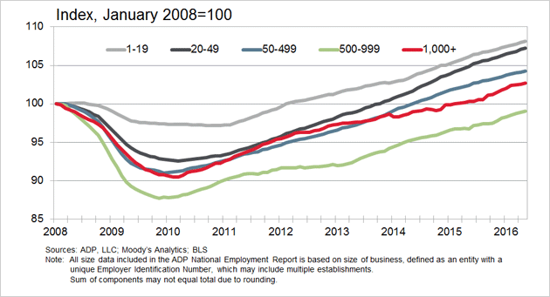
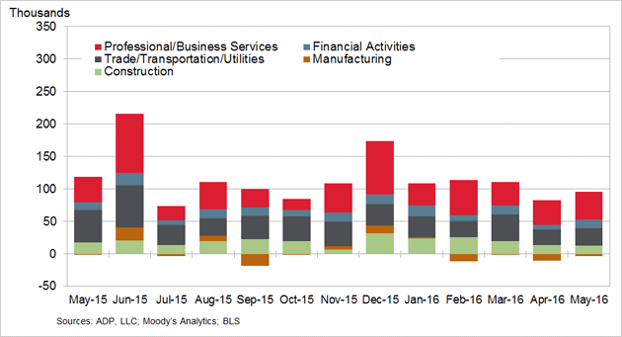
Current state of ADP: STATIC
Change in Nonfarm Private Employment
Change in Total Nonfarm Private Employment
Change in Total Nonfarm Private Employment by Company Size
Change in Total Nonfarm Private Employment by Selected Industry

